Slide 1
Multilayered architecture

Slide 2
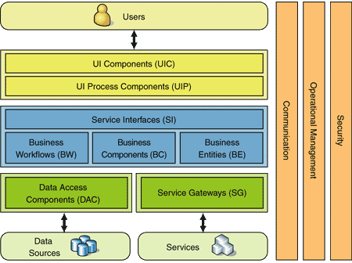
Multilayered architecture example

Slide 3
Example: iBanking

